Slide 1
FPGA Architecture
Sampath

Slide 2
Contents:
Introduction
Soc FPGA
PL
Example
PS
Virtual and Physical Memory
Soft and Hard Processor
Communication between PS and PL
Example

Slide 3
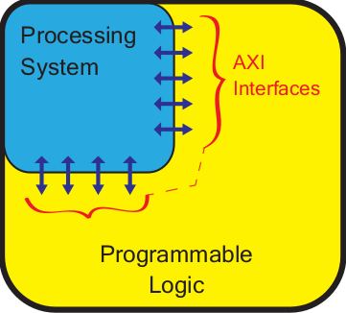
Soc FPGA
PS - Processor System
PL - Programmable logic ( FPGA )
Notes:
PS and PL can be used independently or together.

Slide 4
PL
IOBs
Logic Fabric
Special Resources
DSP48E1
BRAM
Communication Interfaces
GTX Transceivers
Other External Interfaces
XADC Blocks
Clock
Programming and Debugging

Slide 5
IOBs - Input/Output Blocks
Each IOB can handle a 1-bit input or output signal.
Two Categories:
High Performance (HP) - limited to 1.8V and are typically used for high-speed interfaces to memory and other blocks.
High Range (HR) - permit voltages of up to 3.3V and cater for a wider variety of IO standards.
IOSERDES - resource for programmable conversion between parallel and serial data formats (2-8 bits).
Notes:
IOBs are resources that provide interfacing between the PL logic resources.
Organised into banks of 50 IOBs each.
Each IOB contains one pad, which provides the physical connection to the outside world for a single input or output signal.
IOBs are usually located around the perimeter of the device.

Slide 6
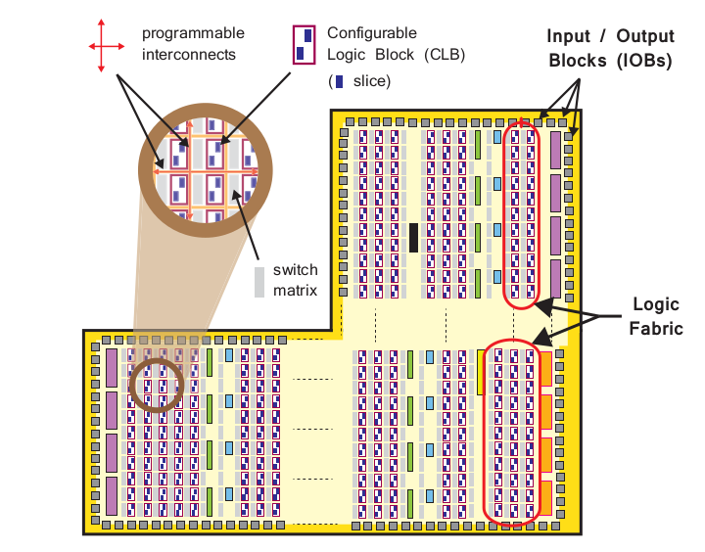
Logic Fabric
Control Logic Block (CLB)
Slice
LUT
FF
Switch Matrix
Carry Logic
Programmable Interconnects

Slide 7
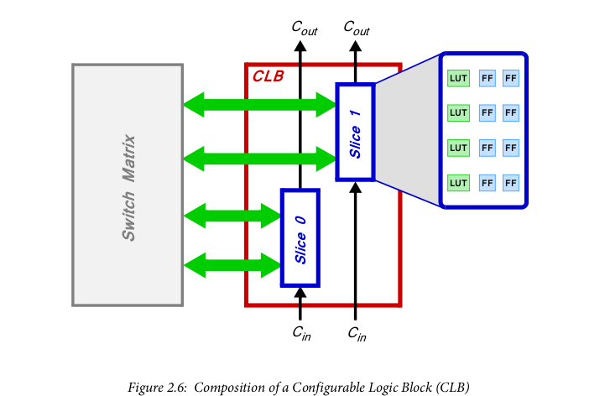
Each CLB has 2 Slices and positioned next to a switch matrix.
CLBs are small, regular groupings of logic elements that are laid out in a two-dimensional array on the PL, and connected to other similar resources via programmable interconnects.

Slide 8
Switch Matrix — A switch matrix sits next to each CLB, and provides a flexible routing facility for making connections
(i) between elements within a CLB; and
(ii) from one CLB to other resources on the PL.
Carry logic — Arithmetic circuits require intermediate signals to be propagated between adjacent slices, and this is achieved via carry logic. The carry logic comprises a chain of routes and multiplexers to link slices in a vertical column.

Slide 9
Slice — A sub-unit within the CLB, which contains resources for implementing combinational and sequential logic circuits. Each slice is composed of 4 Lookup Tables, 8 Flip-Flops, and other logic.
Lookup Table (LUT) — A flexible resource capable of implementing:
(i) a logic function of up to six inputs;
(ii) a small Read Only Memory (ROM);
(iii) a small Random Access Memory (RAM);
(iv) a shift register.
Notes:
LUTs can be combined together to form larger logic functions, memories, or shift registers, as required.
FF is a sequential circuit element implementing a 1-bit register, with reset functionality. One of the FFs can optionally be used to implement a latch.

Slide 10
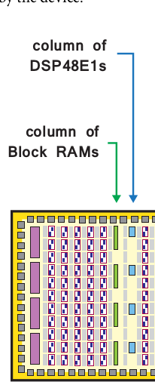
DSP48E1 and BRAM
Both of these resources are integrated into the logic array in a column arrangement, embedded into the fabric logic and normally in proximity to each other (the reason being that intensive computation and storage of data in memory are often closely associated operations).
DSP48E1s and BRAMs are normally clocked at the maximum clock frequency of the device.

Slide 11
BRAM
Used for dense memory requirements.
Can be used as RAM,ROM, FIFO etc.
Each Block RAM can store up to 36 Kb of information and The default word size is 18 bits, and in this configuration each RAM comprises 2048 memory elements.
Notes:
Can be reshaped as our needs and larger capacity memories can be formed by combining two or more Block RAMs together.

Slide 12
DRAM vs BRAM
BRAM - Using a Block RAM means that a large amount of data can be stored in a small physical space on the device, within a dedicated and optimised memory element
DRAM - Distributed RAM, which is constructed from the LUTs within the logic fabric. A significant number of LUTs (spanned over a larger area) are required to form a memory of comparable size to a Block RAM, and the resulting implementation suffers from restricted timing performance due to the increased logic and routing delays.
Advantage of Dram is distributed memories can be located close to the components that interact with them, which can result in fast timing performance i.e (small memories using distributed RAM, both for resource efficiency, and because their placement is more flexible)

Slide 13
DSP48E1
The LUTs in the logic fabric can be used to implement arithmetic operators of any arbitrary length, but are most suitable for arithmetic operators with short wordlengths (arithmetic circuits for long word lengths can have a large footprint in slice logic, with placement and routing factors resulting in sub-optimal clock frequencies).
DSPs are for medium and long word lengths and are used for high-speed arithmetic.
Comprise a pre-adder/subtractor, multiplier, and post-adder/subtractor with logic unit.
DSP48E1s are suited to a variety of applications in signal processing, Image Processing.
Notes:
When used in logic mode, it can perform logical functions instead of arithmetic, and supports all of the fundamental boolean operations: bitwise NOT, AND, OR, NAND, NOR, XOR, and XNOR.
Complex arithmetic can be undertaken, again by combining DSP48E1s, and the word lengths are also suitable for implementing floating point arithmetic.

Slide 14
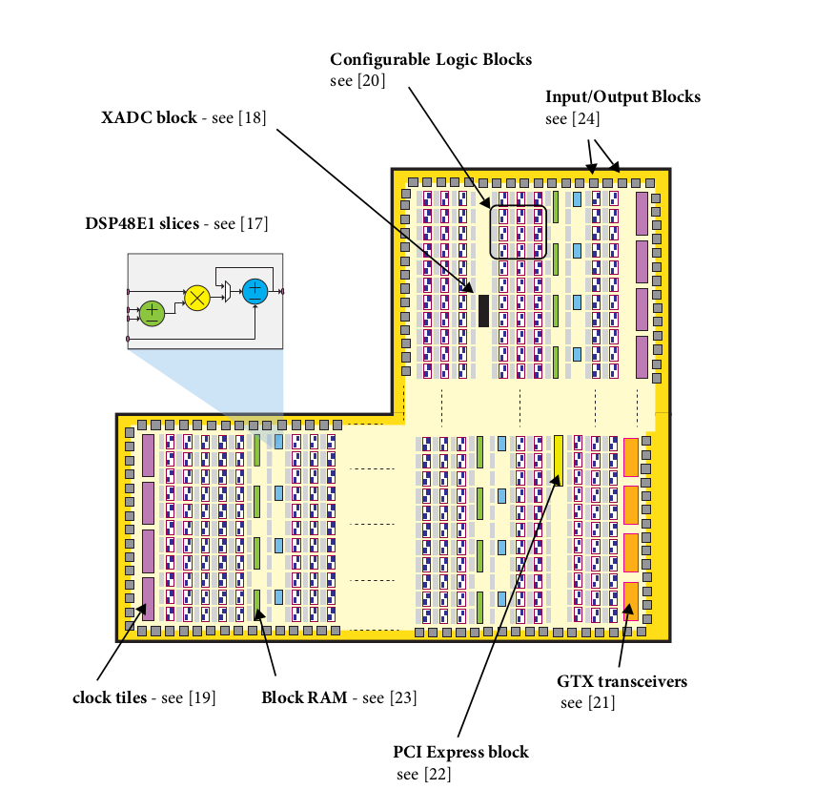
GTX transceivers are high-speed communications interface blocks which are embedded into the logic fabric.
GTX Transceivers are implemented as ‘quads’, i.e. groups of 4 individual channels, each of which comprises a dedicated Phase Locked Loop (PLL) for that channel, a transmitter, and a receiver.
rates of up to 12.5Gbps based on zynq device.
Notes:
support is provided via a Wizard tool which automatically creates a core for the desired interface.

Slide 15
Analogue to Digital Converter (ADC)- Features two separate 12-bit ADCs both capable of sampling external analogue input signals at 1Msps.
Clock-The PL receives four separate clock inputs from the PS, and additionally has the facilities to generate and distribute its own clock signals independently of the PS.
Programming and Debug — A set of JTAG ports are provided in the PL section to facilitate configuration and debugging of the PL.
Notes:
Control of the XADC is achieved using the PS-XADC interface block located within the PS, and the PS-XADC control block can itself be programmed from software executing on the APU.

Slide 16
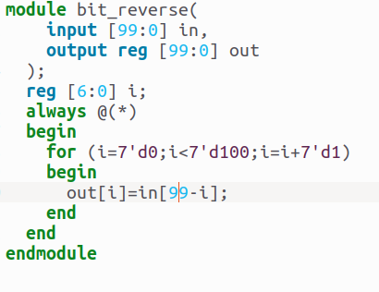
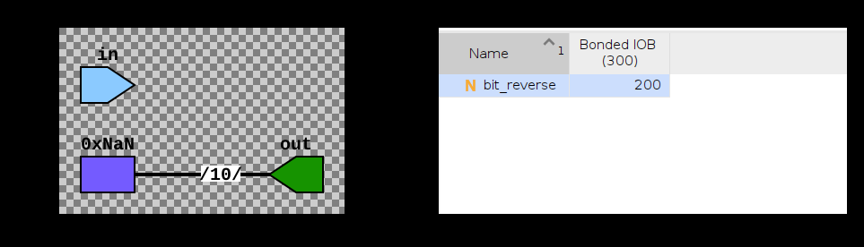
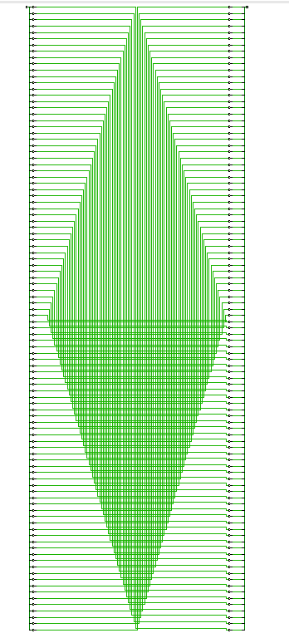
Example1

Slide 17
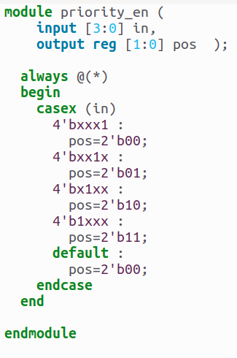
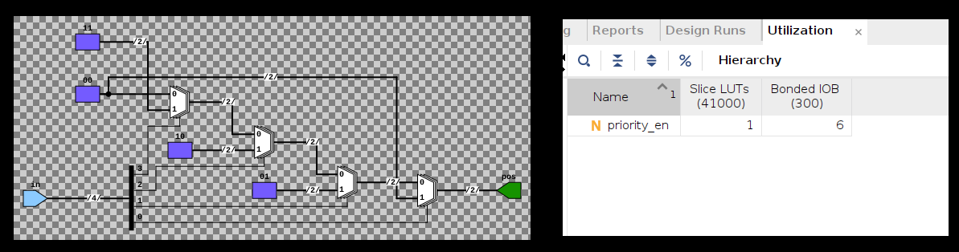
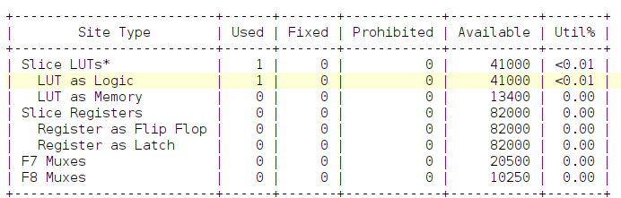
Example 2

Slide 18
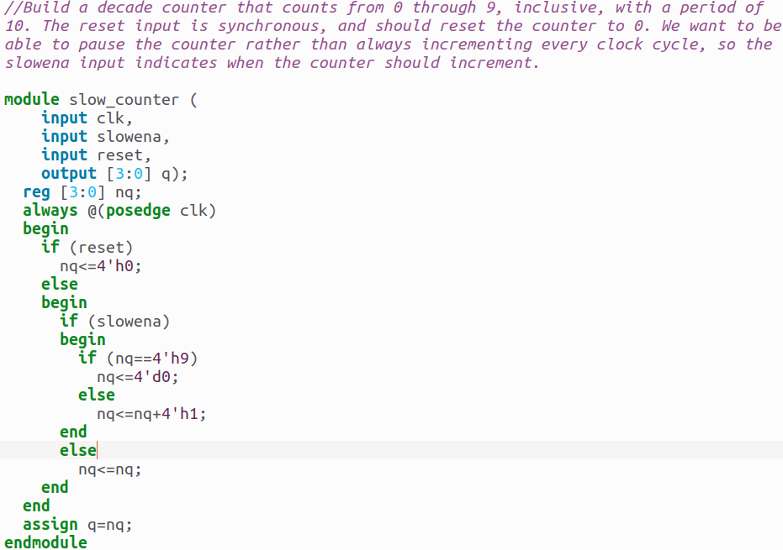
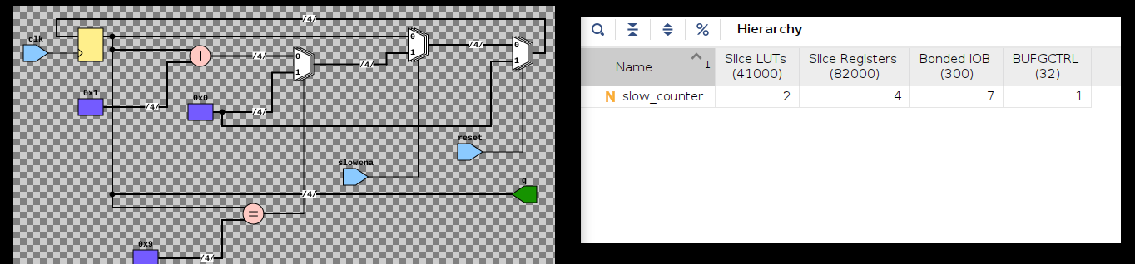
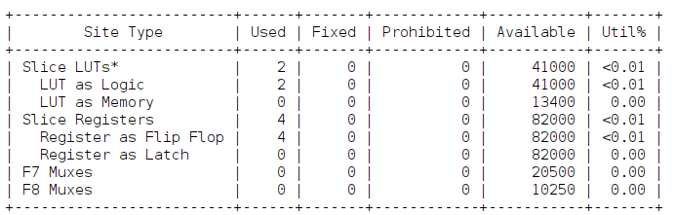
Example 3

Slide 19
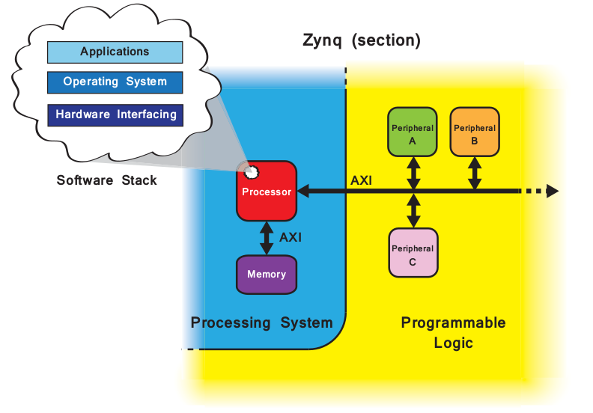
Processor System (PS)
PS has:
2 Core arm cortex A9 processor
Application Processing Unit (APU)
Peripheral interfaces
Cache memory
Memory interfaces
Interconnect
Clock generation circuitry
Notes:
Peripherals are functional components that are residing away from the processor.
Need to be Connected if you want to use.
3 main functions:
Co processors (dma).
Interacting with external Interfaces (led,sw,pb,codec etc).
Additional Memory Elements.
IPs corresponds to Peripheral Components.
PS is completely flexible, we can create custom peripherals or use standard ones.

Slide 20
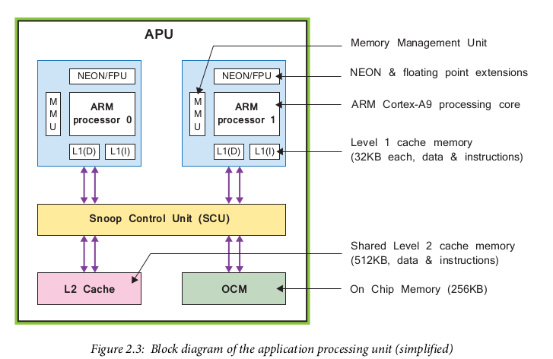
APU
Each Processor Cores includes separate :
NEON™ Media Processing Engine (MPE) and Floating Point Unit (FPU).
Memory Management Unit (MMU).
Level 1 cache memory (two sections for instruction and data).
Snoop Control Unit (SCU)
Level 2 cache memory
On Chip Memory
Timers and an interrupt controller
Notes:
Processor Core can operate up to 1GHz based on zynq device.
L1 Cache - permits local storage of frequently required data and instructions for fast access times and optimal processor performance.

Slide 21
NEON Engine
NEON engine provides Single Instruction Multiple Data (SIMD) facilities to enable strategic acceleration of media and DSP type algorithms.
NEON instructions are an extension to the standard ARM instruction set, and can either be used explicitly, or by ensuring that the C code follows an expected form and thus allows NEON operations to be inferred by the compiler.
NEON supports a variety of data types including signed and unsigned integers, single precision floating point, and half-precision floating point; however, double precision is not supported.
Notes:
As the SIMD term suggests, the NEON engine can accept multiple sets of input vectors, upon which the same operation is performed simultaneously to provide a corresponding set of output vectors. This style of computation caters well to applications like image and video processing, which operate on a large number of data samples (pixels) simultaneously, and inherently parallel, generic signal processing functions such as Finite Impulse Response (FIR) filters and Fast Fourier Transforms (FFTs).

Slide 22
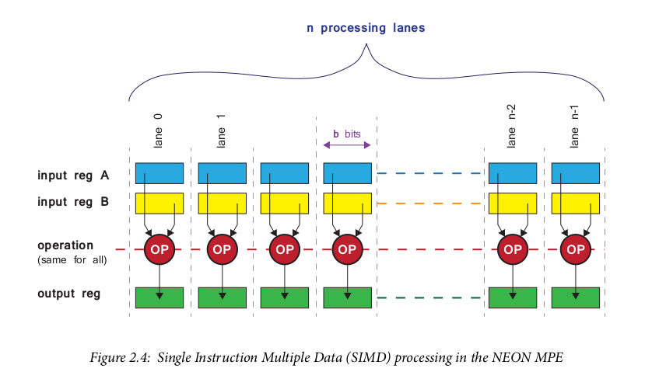
There are two input registers, A and B, each of which contain a set of N individual input vectors. A single defined operation is performed between the N sets of input vectors to produce a corresponding set of output vectors which are written to the output register. The size of the vectors can vary, as can the number of vectors comprising each register; the important feature is that each ‘lane’ produces results arising from the same operation, which is performed on several different sets of inputs at the same time; hence the term single instruction multiple data.

Slide 23
FPU
The Floating Point Unit (FPU) (which does not possess SIMD capabilities) is required if double precision computation is needed.
FPU are referred to as ‘Floating Point Extensions’, or ‘VFP Extensions’ (Vector Floating Point). The unit provides hardware acceleration of floating point operations in compliance with the IEEE 754 standard, and supports single and double precision formats, with some additional support for half-precision and integer conversion.

Slide 24
MMU
The primary role of the Memory Management Unit (MMU) is to translate between virtual and physical addresses.
Virtual and Physical Memory:
PAGE table - contains mapping information allows processor to resolve virtual memory addresses to physical ones.
Page - is a segment of memory has unique PFN (Page Frame Number)

Slide 25
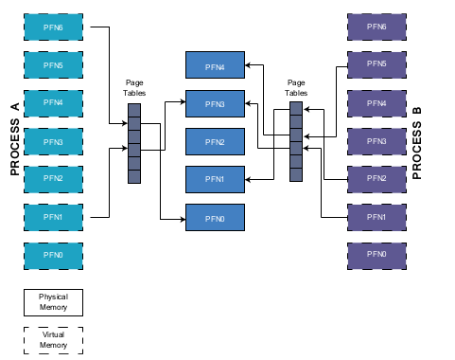
Process A has virtual PFN1 mapped to physical PFN3. In order to translate this virtual PFN1 into physical PFN3 the processor will use an offset within the virtual page as an index to the page table.
If the entry at that offset is valid, a physical PFN is retrieved. If not and the process is trying to access non-existent regions of memory then the address cannot be resolved and the operating system is notified of a page fault to be dealt with.
Several virtual PFNs from different processes can be mapped to the same physical PFN, as is observed with entries from both Process A and B mapped to PFN3 in physical memory. This allows the system to operate with a large address space, where the system appears to have more memory than is physically present. Virtual address spaces are independent for each process and so are offered a level of protection through separation, preventing code or data from undesired overwrites.
Notes:
From a programming perspective, support for ARM instructions is provided via the Software (Written in C) which includes all necessary components to develop software for deployment on the ARM processor.
Virtual address spaces are independent for each process and so are offered a level of protection through separation, preventing code or data from undesired overwrites.

Slide 26
SCU
Snoop Control Unit (SCU) forms a bridge between the ARM cores and the Level 2 cache and OCM memories.
‘Snooping’ is one of several mechanisms for ensuring cache coherency, i.e. managing the consistency of data across shared cache resources.
The SCU is responsible for maintaining memory coherency between the processor data cache memories L1(D) and the shared Level 2 cache memory. It also initiates and controls access to the Level 2 cache, arbitrating between requests from the two cores where necessary.
The SCU additionally manages transactions that take place between the PS and PL via the Accelerator Coherency Port (ACP).
Notes:
This unit also has some responsibility for interfacing with the PL (ACP interface, which is connected directly to the Snoop Control Unit inside the APU.)
The Snoop Control Unit undertakes several tasks relating to interfacing between the processors and Level 1 and 2 cache memories.

Slide 27
PS I/O Interfaces:
SPI
I2C
CAN
UART
GPIO
SDCARD
USB
EMAC(gig-e) (10,100 Mbps,1Gbps)

Slide 28
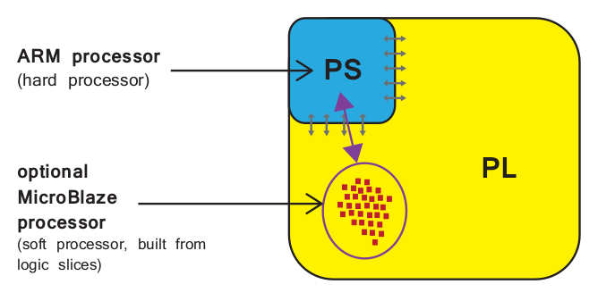
Soft processor vs Hard Processor
Microblaze, nios.
IP block deployed in the logic fabric of an FPGA
With Soft Processor number and precise implementation of processor instances is flexible
Hard Processor can achieve considerably higher performance
Notes:
One or more soft processors can be used within the PL portion to operate in conjunction with the processor.

Slide 29
Communication between PS and PL
Using AXI (Advanced eXtensible Interface) Interfaces of AMBA Standard by ARM.
Three types of AXI : AXI, AXI-LITE, AXIS
The primary interface between the PS and PL is via a set of nine AXI interfaces, each of which is composed of multiple channels. These make dedicated connections between the PL, and interconnects within the PS.
Notes:
Many devices and IP blocks produced by third party manufacturers and developers are based on this standard.

Slide 30
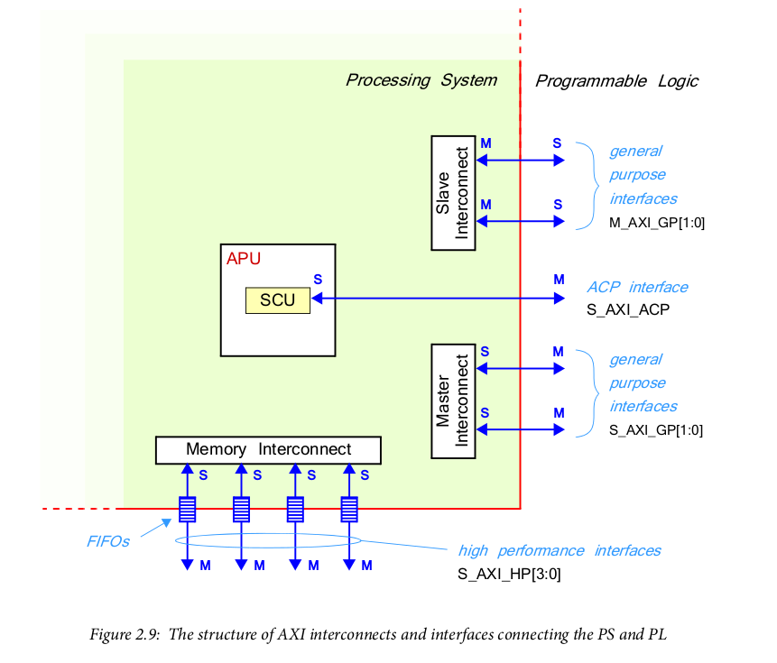

Slide 31
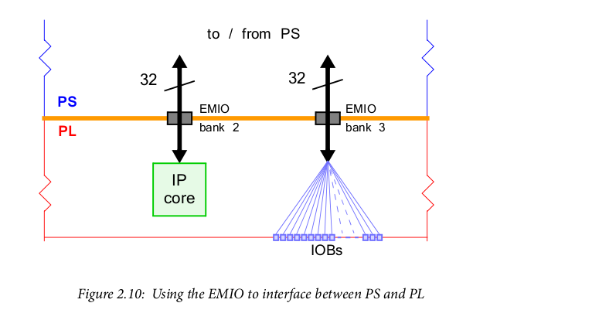
Other topics:
Other signals crossing the PS-PL boundary include watchdog timers, reset signals, interrupts, and DMA interfacing signals.
EMIO- several connections from the PS can be routed through the PL to external interfaces, and this is referred to as Extended MIO, or EMIO.

Slide 32
Interconnect vs Interface
Interconnect — An interconnect is effectively a switch which manages and directs traffic between attached AXI interfaces. There are several interconnects within the PS, some which are directly interfaced to the PL and others which are for internal use only. The connections between these interconnects are also formed using AXI interfaces.
Interface — A point-to-point connection for passing data, addresses, and hand- shaking signals between master and slave clients within the system.

Slide 33
Example
PS and PL led blinking with C Software.

Slide 34
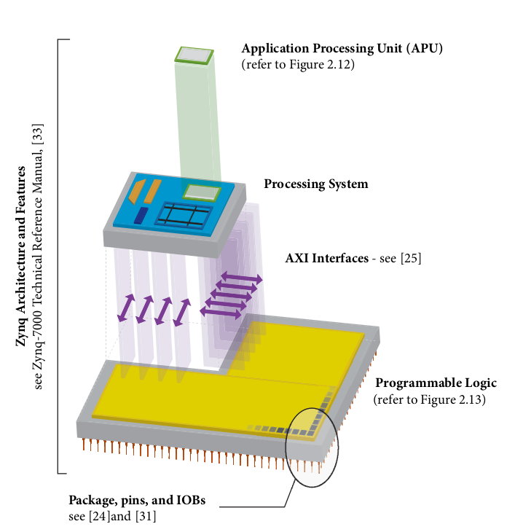
Architecture

Slide 35
References
Xilinx Zynq book.

